Slide 1


The eXtensible Markup Language
Dr. Jenila Livingston L.M.
SCOPE

Slide 2
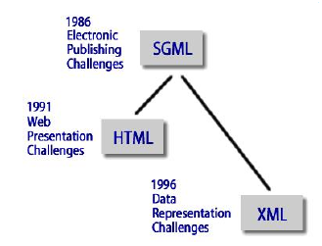
Background for XML
An Extensible Markup
Language (XML) document
describes the structure of data
XML and HTML have a similar syntax … both derived from SGML (Standard Generalized Markup Language)
An XML document resides in its own file with an ‘.xml’ extension
Dr. L.M. Jenila Livingston, VIT Chennai

Slide 3
Quick Comparison
HTML
- uses tags and attributes
- content and formatting can be placed together
<p><font=”Arial”>text</font>
- tags and attributes are pre-determined and rigid
XML
- uses tags and attributes
- content and format are separate; formatting is contained in a stylesheet
- allows user to specify what each tag and attribute means
Dr. L.M. Jenila Livingston, VIT Chennai

Slide 4
HTML and XML
HTML
  describes web pages
  You don’t get error messages about the web pages you visit
  Browsers ignore and/or correct as many HTML errors as they can, so HTML is often sloppy
XML
  XML describes data
  The rules are strict and errors are not allowed
    In this way, XML is like a programming language
  Current versions of most browsers can display XML
    However, browser support of XML is spotty at best
Dr. L.M. Jenila Livingston, VIT Chennai

Slide 5
Example of an HTML Document
<html>
<head><title>Example</title></head.
<body>
<h1>This is an example of a page.</h1>
<h2>Some information goes here.</h2>
</body>
</html>
Dr. L.M. Jenila Livingston, VIT Chennai

Slide 6
XMLRules
XML is case sensitive
All start tags must have end tags
Tags must be properly nested
  <name><email>…</name></email> is not allowed.
  <name><email>…</email><name> is.
XML declaration is the first statement
Every document must contain a root element
Dr. L.M. Jenila Livingston, VIT Chennai

Slide 7
XML Rules
Attribute values must have quotation marks
Certain characters are reserved for parsing
Tags are enclosed in angle brackets.
Tags that do not have end-tags must be terminated by a ‘/’.
  <br /> is an html example.
Dr. L.M. Jenila Livingston, VIT Chennai

Slide 8
The pieces
There are 3 components for XML content:
- the XML document
- DTD (Document Type Declaration)
- XSD (XML Schema Definition)
Dr. L.M. Jenila Livingston, VIT Chennai

Slide 9
XML Comments
<!-- --> comments
- contents are ignored by the processor
- cannot come before the XML declaration
- cannot appear inside an element tag
- may not include double hyphens
Dr. L.M. Jenila Livingston, VIT Chennai

Slide 10
XML Declaration
<?xml
version ="version_number"
encoding ="encoding_declaration"
standalone="standalone_status"
?>
encoding – the character encoding used in the document
standalone –if an external DTD is required
<?xml version=”1.0” encoding=”UTF-8”>
<?xml version=”1.0” standalone=”yes”>
Dr. L.M. Jenila Livingston, VIT Chennai

Slide 11
XML Trees
An XML document has a single root node.
The tree is a general ordered tree.
  A parent node may have any number of children.
  Child nodes are ordered, and may have siblings.
Preorder traversals are usually used for getting information out of the tree.
Dr. L.M. Jenila Livingston, VIT Chennai

Slide 12
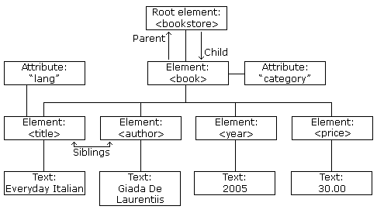

XML Tree Structure
Dr. L.M. Jenila Livingston, VIT Chennai

Slide 13
XML Tree Structure
<root>
<child>
<subchild>.....</subchild>
</child>
</root>
Dr. L.M. Jenila Livingston, VIT Chennai

Slide 14
Address - Tree Representation
address
name
email
phone
birthday
first
last
year
month
day
Dr. L.M. Jenila Livingston, VIT Chennai

Slide 15
Example 1: XML document for the given tree
<?xml version = “1.0” ?>
<address>
<name>
<first>Jafflyn</first>
<last>Leni</last>
</name>
<email>leni@gmail.com</email>
<phone>+91-91414-14141</phone>
<birthday>
<year>2007</year>
<month>04</month>
<day>21</day>
</birthday>
</address>
Dr. L.M. Jenila Livingston, VIT Chennai

Slide 16
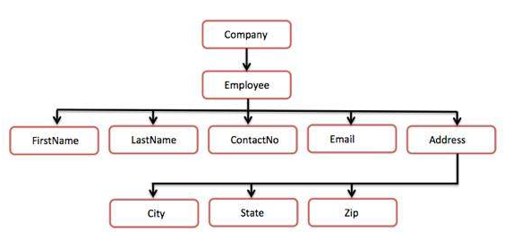
Company - Tree representation
Dr. L.M. Jenila Livingston, VIT Chennai

Slide 17
Example 2: XML document for the given tree
<?xml version = "1.0"?>
<Company>
  <Employee>
    <FirstName>Frank</FirstName>
    <LastName>Len</LastName>
    <ContactNo>1234567890</ContactNo>
    <Email>frank@xyz.com</Email>
    <Address>
      <City>Bangalore</City>
      <State>Karnataka</State>
      <Zip>560212</Zip>
    </Address>
  </Employee>
    </Company>
Dr. L.M. Jenila Livingston, VIT Chennai

Slide 18
Example 3: XML document
<?xml version="1.0“?>
<weatherReport>
<date>7/1/2020</date>
<city>Chennai</city>
<state>TN</state>
<country>India</country>
High Temp: <high scale="F">103</high>
Low Temp: <low scale="F">70</low>
Morning: <morning>Partly cloudy, Foggy</morning>
Afternoon: <afternoon>Sunny &amp; hot</afternoon>
Evening: <evening>Clear and Cool</evening>
</weatherReport>
Dr. L.M. Jenila Livingston, VIT Chennai

Slide 19
XML attribute number=“1”
novel
foreword
chapter
number="1"
paragraph
paragraph
paragraph
This is the great
American novel.
It was a dark
and stormy night.
Suddenly, a shot
rang out!
Dr. L.M. Jenila Livingston, VIT Chennai

Slide 20
Example 4: XML Attributes
<novel>
<foreword>
<paragraph> This is the great American novel.
</paragraph>
</foreword>
<chapter number="1">
<paragraph>It was a dark and stormy night.
</paragraph>
<paragraph>Suddenly, a shot rang out!
</paragraph>
</chapter>
</novel>
Dr. L.M. Jenila Livingston, VIT Chennai

Slide 21
Example 5: XML Attribute
<person gender=“Female">
<firstname>Jafflyn</firstname>
<lastname>Leni</lastname>
</person>
<person>
<gender>Female</gender>
<firstname>Jafflyn</firstname>
<lastname>Leni</lastname>
</person>
Dr. L.M. Jenila Livingston, VIT Chennai

Slide 22
Document Type Definitions (DTD)
A DTD describes the tree structure of a document and something about its data.
There are two data types, PCDATA and CDATA.
  PCDATA is parsed character data.
  CDATA is character data, not usually parsed.
A DTD determines how many times a node may appear, and how child nodes are ordered.
Dr. L.M. Jenila Livingston, VIT Chennai

Slide 23
PCDATA
PCDATA is text that will be parsed by a parser. Tags inside the text will be treated as markup and entities will be expanded.
PCDATA is the only plain text content model.
Dr. L.M. Jenila Livingston, VIT Chennai

Slide 24
CDATA
CDATA is text that will not be parsed by a parser. Tags inside the text will not be treated as markup and entities will not be expanded.
The predefined entities such as &lt;, &gt;, and &amp; quote(') and double quote (") require typing and are generally difficult to read in the markup. In such cases, CDATA section can be used.
<![CDATA[ characters with markup ]]>
Dr. L.M. Jenila Livingston, VIT Chennai

Slide 25
Internal DTD
<?xml version="1.0" encoding="UTF‐8" standalone="yes" ?>
<!DOCTYPE address [
<!ELEMENT address (name,company,phone)>
<!ELEMENT name (#PCDATA)>
<!ELEMENT company (#PCDATA)>
<!ELEMENT phone (#PCDATA)>
]>
<address>
<name> Frank</name>
<company>GE</company>
<phone>044‐333335</phone>
</address>
Dr. L.M. Jenila Livingston, VIT Chennai

Slide 26
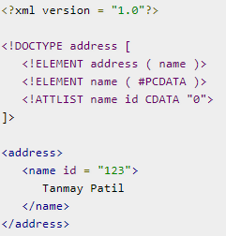
CDATA
<!ATTLIST element-name attribute-name attribute-type "default-value">
Dr. L.M. Jenila Livingston, VIT Chennai

Slide 27
External DTD
In external DTD elements are declared outside
the XML file. They are accessed by specifying the
system attributes which may be either the
legal .dtd file or a valid URL.
Dr. L.M. Jenila Livingston, VIT Chennai

Slide 28
External DTD – Example1
address.dtd
<!ELEMENT address (name,company,phone)>
<!ELEMENT name (#PCDATA)>
<!ELEMENT company (#PCDATA)>
<!ELEMENT phone (#PCDATA)>
Dr. L.M. Jenila Livingston, VIT Chennai

Slide 29
External DTD – E.g. 1 contd..
<?xml version="1.0" encoding="UTF‐8" standalone="no"?>
<!DOCTYPE address SYSTEM "address.dtd">
<address>
<name> Frank</name>
<company>GE</company>
<phone>044‐333335</phone>
</address>
Dr. L.M. Jenila Livingston, VIT Chennai

Slide 30
External DTD for address Example 2
Address.dtd
<!ELEMENT address (name, email, phone, birthday)>
<!ELEMENT name (first, last)>
<!ELEMENT first (#PCDATA)>
<!ELEMENT last (#PCDATA)>
<!ELEMENT email (#PCDATA)>
<!ELEMENT phone (#PCDATA)>
<!ELEMENT birthday (year, month, day)>
<!ELEMENT year (#PCDATA)>
<!ELEMENT month (#PCDATA)>
<!ELEMENT day (#PCDATA)>
Dr. L.M. Jenila Livingston, VIT Chennai

Slide 31
External DTD – E.g. 2 contd..
<?xml version="1.0" encoding="UTF‐8" standalone="no" ?>
<!DOCTYPE address SYSTEM "address.dtd">
<?xml version = “1.0” ?>
<address>
<name>
<first>Jafflyn</first>
<last>Leni</last>
</name>
<email>leni@gmail.com</email>
<phone>+91-91414-14141</phone>
<birthday>
<year>2007</year>
<month>04</month>
<day>21</day>
</birthday>
</address>
Dr. L.M. Jenila Livingston, VIT Chennai

Slide 32

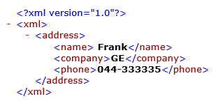
XML output in browser
Address.xml
<xml>
<address>
<name> Frank</name>
<company>GE</company>
<phone>044‐333335</phone>
</address>
</table>
</xml>
Dr. L.M. Jenila Livingston, VIT Chennai

Slide 33
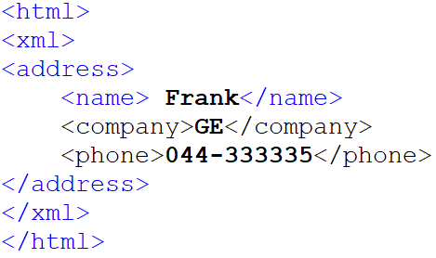
Data Islands
XML can be used to store data inside HTML documents. XML data can be stored inside HTML pages as "Data Islands".
xmlbind.html
Output
Dr. L.M. Jenila Livingston, VIT Chennai

Slide 34
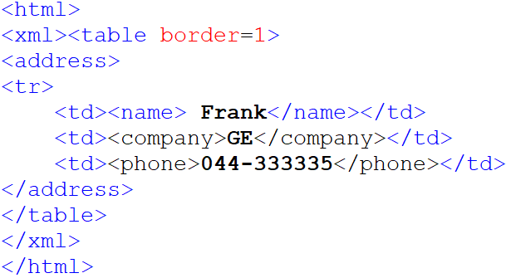

Data Islands
xmlbind2.html
Output:
Dr. L.M. Jenila Livingston, VIT Chennai

Slide 35
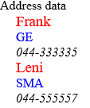
CSS Style
Dr. L.M. Jenila Livingston, VIT Chennai

Slide 36
CSS style
Steps:
Create a style document using CSS
Create an XML document for Address DB
style.css
Dr. L.M. Jenila Livingston, VIT Chennai

Slide 37
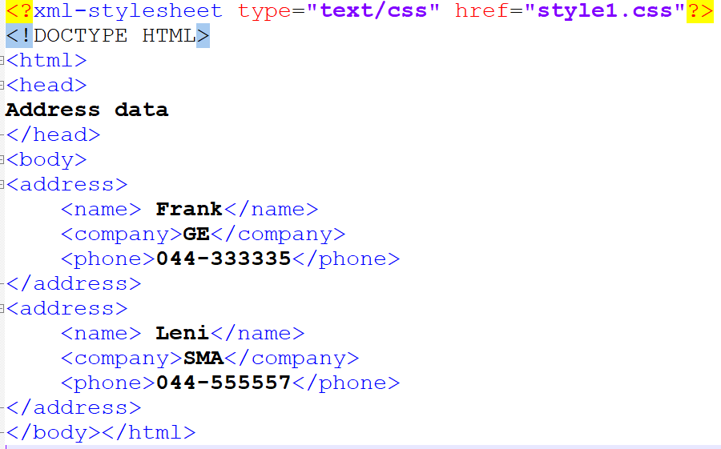
address.xml
Dr. L.M. Jenila Livingston, VIT Chennai

Slide 38

Dr. L.M. Jenila Livingston, VIT Chennai

